Slide 1
Functional Programming
Adopting functional programming principles in Delphi

Slide 2
Functional Programming Principles
Pure Functions ALWAYS return the same result when called with the same parameters
Immutability – once assigned a value can’t be changed
Functional Programs are Declarative – list the steps required to reach the outcome
State is maintained through composition (joining functions together) not by storing properties

Slide 3
Benefits
Predictability – you can see what will happen just by looking at the signature of the method
Brevity – (usually) functions are smaller than equivalent imperative code
Maintainability – locating bugs are typically easier (often self evident)
Testability – each “element” of the code is inherently independently testable
Parallel processing and Task queuing is much easier

Slide 4
Problems
Jargon – side effects, functors, high order functions …
It’s a paradigm shift for OO programmers
Immutability can be heavy on memory and requires some care (eg mobile devices)

Slide 5
Functional Principles in OO
Make the Method signatures definitive (honest)
The name should says exactly what it does
Return type and parameter types are explicit
Eliminate side-effects
Avoid Primitive types in favour of Value Types
Refactor away from using Exceptions to control flow
Functional Composition (& Railway oriented programming)
(Fail Fast principle)
(Avoid returning nil)

Slide 6
Quick Examples: Small Demonstration

Slide 7
CSV Updater Project
CSVUpdater is a demo project I thought might be a good way to demonstrate functional programming.
Key points are that CSV files are often implemented wrongly (CRLF can be used in DATA)
Starts with purely OO approach and eventually will end up with as functional as we can make it
Part 1 deals with immutability and just some aspects of code honesty – long way to go
Want to reach a point where the original CSVUpdater becomes to be agnostic of format and data source (Tab delimited, Web source, In memory) and can be safely run in a parallel processing environment.

Slide 8
Large Demonstration

Slide 9
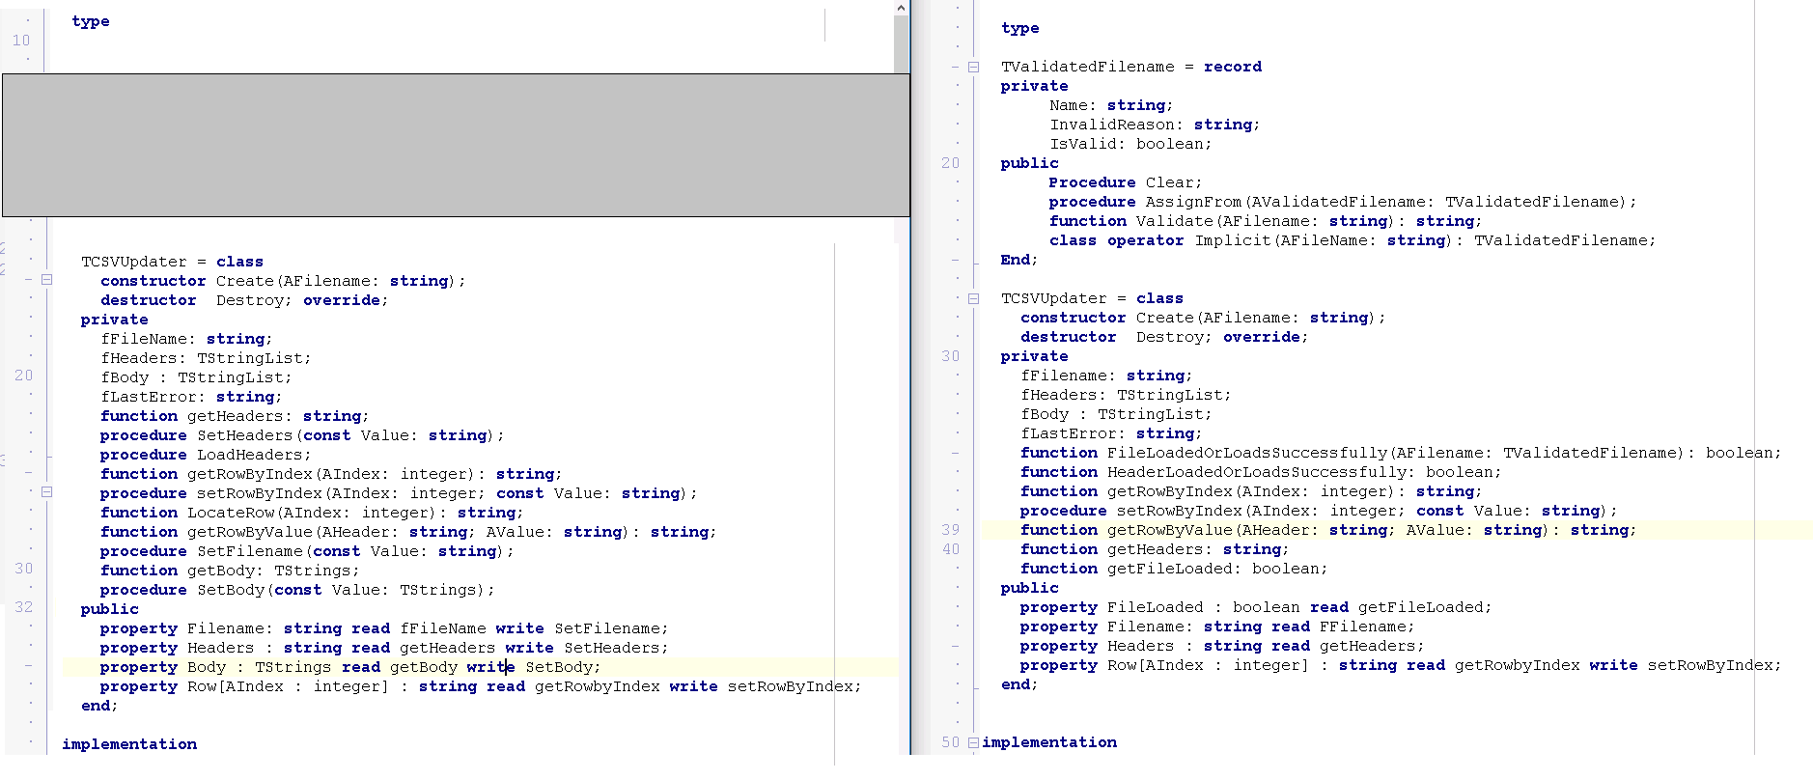
Class Changes

Slide 10
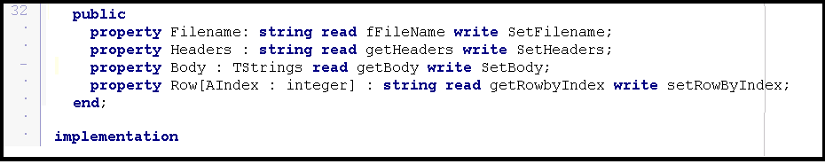
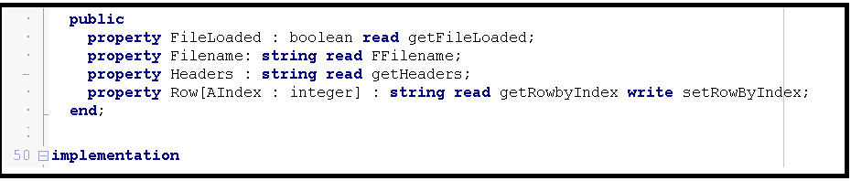
Immutability helps reduce complexity related to maintaining state

Slide 11
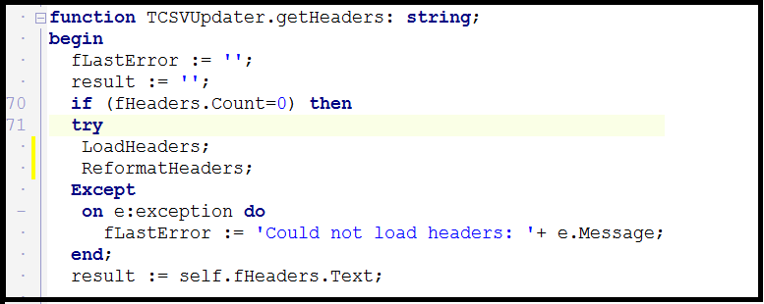
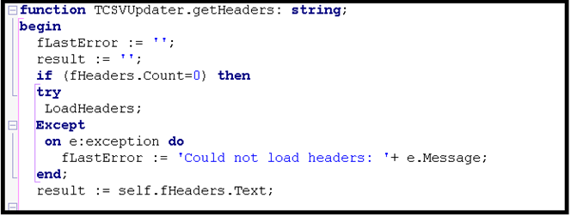
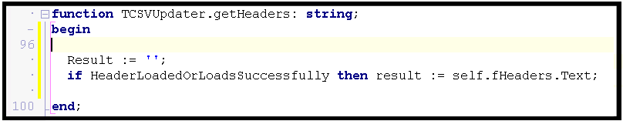
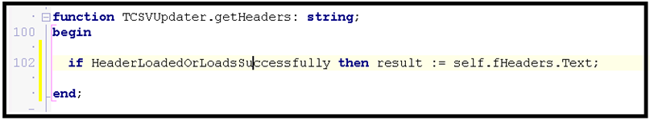
Reduce complexity, use composition and avoid using exceptions to control program flow.
Exception
GOTO Semantics
Result := ‘’;
Composition
Notes:
Increased readability reduces ambiguity – it is concise and there is nothing here that does not relate to the function
Describes what it does and says how it does it.
Function itself only does the one thing it is asked to do.
Removes the GOTO semantics – exceptions should not control program flow.
It might cause other things to happen but that is because it is a “Higher Order” function which is a result of composition.
The Goto Symantics are a little hidden here, but if there was more than one task inside the catch block we would not be able to tell which of those things could cause an error.

Slide 12
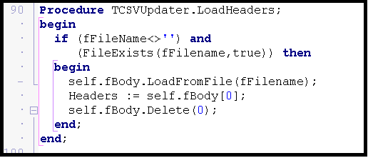
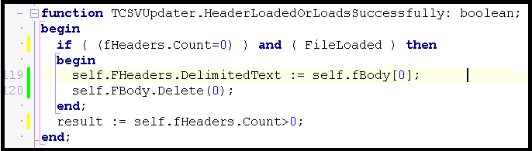
Describing more honestly what is done helps identify and reduce side effects.
Composition
Higher Order Function
HeadersAreEmpty
HeadersAreEmptyAndFileLoadedOrLoadsOK
In-line (pure) function
Notes:
Pros:
The Signature of the method tells you what it is really doing – Easier to Maintain
It lets you know if it worked or not and is therefore composable

Slide 13
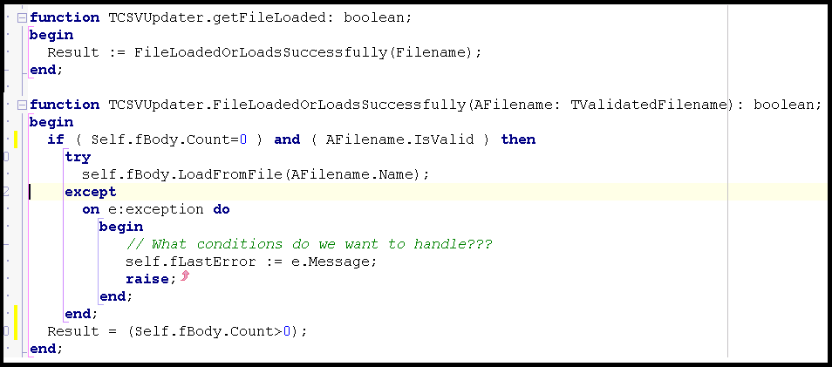
Loading the file is now a separate step.
Notes:
This is a place where we actually made more lines of code overall, but each of the parts makes more sense and gives greater control.
FileLoaded is a boolean property which is still a little deceptive – And would be the next thing to re-factor, but we’ll leave it here.

Slide 14
Handle exceptions at the lowest level.
Exception
Notes:
The Exception happened where we describe the issue (Previous propagated up and you would be looking for the reason in the wrong place.
Make sure the Exception is truly exceptional. Handle anything that is reasonable to expect. Exceptional is something as a user you could expect to fix by just trying again (file locked, server down). OR if you are a developer and you have done something wrong (ie misused the API or interface)

Slide 15
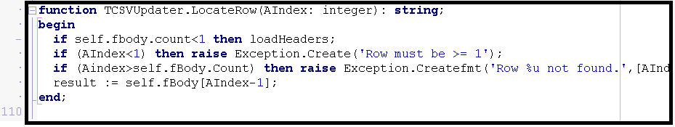
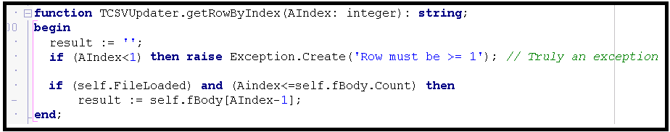
Fail fast, and exceptions are truly exceptional
Developer has done exceptional if we’re here
Fail Fast- as soon as the problem is detectable
Notes:
Not much change here except that The exception

Slide 16
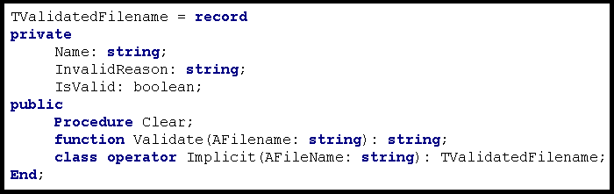
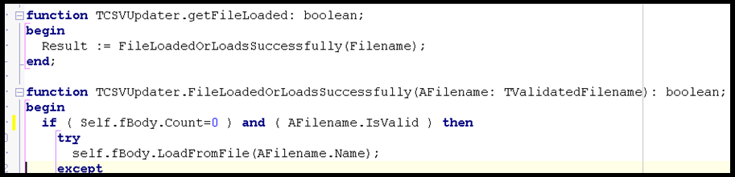
Overcome Primitive Obsession: Accept only the data that you know is correct by creating Value Objects
Notes:
The rules relating to the validation of the Filename are conceptual -

Slide 17
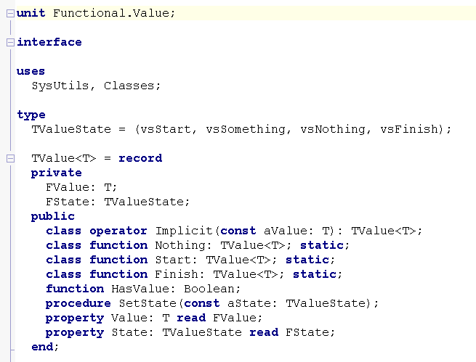
Functional Libraries are available to manage Generic Value Type Objects

